Slide 1
Welcome to Hello World Series
Introduction to Centralized Version Control

Slide 2
In last tutorial...
We discussed about managing file changes using database, but that also didn’t work out.

Slide 3
In this tutorial...
We will see, what is “Centralized Version Control.

Slide 4
Introduction to Centralized Version Control
To solve collaboration problem among developers, Centralized Version Control Systems were developed.

Slide 5
Frequently used Centralized Version Control Systems
To solve collaboration problem among developers, Centralized Version Control Systems were developed.

Slide 6

Frequently used Centralized Version Control Systems

Slide 7

Frequently used Centralized Version Control Systems

Slide 8

Frequently used Centralized Version Control Systems

Slide 9
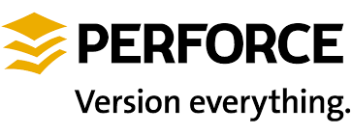
Frequently used Centralized Version Control Systems

Slide 10
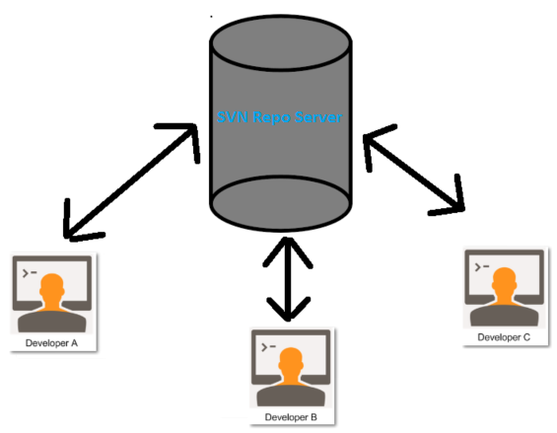
How Centralized Version Control System works
“Central” copy

Slide 11
How Centralized Version Control System works
Pull any changes from the central server, what other developers have made to central server.
Make your changes, and make sure they work properly.
Push your changes to the central server, so other developers can see them.
“Central” copy

Slide 12
Looks cool…
“Central” copy
This solution is not best, but far better than our home grown approaches for file changes tracking and sharing.

Slide 13
Let’s understand “Centralized” concept in detail
Watch next tutorial for the this…

Slide 14
Coming up Next
How Centralized Version Control Systems work
Notes:
In Slide Show mode, click the arrow to enter the PowerPoint Getting Started Center.

